Slide 1

ProductIQ
AI-Driven Product Feedback Analysis
An Explainable AI Agent for Intelligent Product Roadmaps
Presented by: Anuvid Mishra
Batch: MCA 2025 SEC (A)
Institution: Alliance University
Date: 12/22/2025

Slide 2
The Product Feedback Conundrum
Unstructured Feedback Overload
Slow & Biased Analysis
User feedback is often scattered across multiple channels and lacks a consistent structure, making it difficult to aggregate and interpret manually.
Manual analysis of feedback is not only time-consuming but also susceptible to human biases, leading to skewed interpretations and missed insights.
Ambiguous Prioritization
Unjustified Product Decisions
Without clear data, feature prioritization becomes subjective and contentious, leading to internal disagreements and suboptimal resource allocation.
Product decisions made without a solid, data-driven foundation are challenging to defend and often fail to address true user needs, impacting product success.

Slide 3
Introducing Our Intelligent Solution
"From raw feedback to data-driven decisions."
AI-Powered Analysis Platform
1
Our system leverages advanced AI to process and understand vast quantities of user feedback.
Automated Feature Conversion
2
It intelligently translates qualitative feedback into actionable, well-defined product features.
AI-Driven Prioritization
3
Features are prioritized based on sophisticated AI logic, optimizing for impact and feasibility.
Explainable Reasoning
4
Crucially, the system provides transparent explanations for its decisions, fostering trust and clarity.

Slide 4
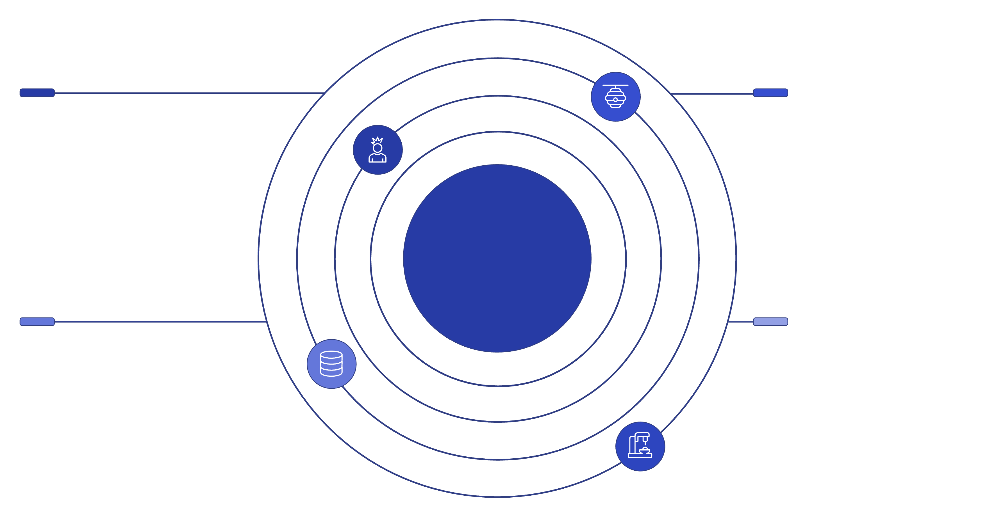




System Architecture Overview
The AI Agent forms the core engine, bridging user interaction with robust data management.
React Frontend
Django REST Backend
User interface for interaction and visualization
API layer handling requests and business logic
AI Agent Layer
PostgreSQL Database
Dockerized Deployment
Persistent structured data storage and queries
Containerized services for scalable environments
Our modern, scalable architecture ensures efficient processing and deployment across various environments.

Slide 5






AI Agent Workflow: From Feedback to Feature
Feedback Submission
Users submit feedback through various channels, which is then captured and ingested by the system.
Similarity Matching
The AI agent analyzes new feedback, identifying patterns and matching it with existing feature concepts.
Feature Mapping or Creation
Feedback is either mapped to an existing feature or, if novel, triggers the creation of a new feature proposal.
Priority, Impact, Effort Calculation
AI assesses the potential priority, user impact, and development effort for each proposed or updated feature.
AI Reasoning Generation
Detailed, transparent reasoning is generated to explain why certain prioritization decisions were made.
Feature Update & Roadmap Integration
The system updates the product roadmap with the new or reprioritized feature, ready for product teams.

Slide 6




Unpacking AI Decision Logic
Our approach prioritizes explainable logic over opaque "black-box" AI models.
Similarity Score Threshold
Aggregate Feedback Entries
Determines how closely new feedback must match existing features to be grouped, ensuring relevance.
The volume and frequency of similar feedback directly influence a feature's urgency and importance.
Confidence Score
Impact & Effort Estimation
A metric indicating the AI's certainty in its analysis and mapping, reducing false positives.
AI models forecast the potential user impact and development effort, guiding prioritization for optimal ROI.

Slide 7

Robust Data Model & Traceability
Our system ensures complete transparency and accountability in product development.
Core Entities:
Feedback: Raw user input and sentiment.
Feature-Feedback Mapping
Feature: Actionable product enhancements derived from feedback.
Mapping entity enabling many-to-many links.
Feature–Feedback Mapping: Links specific feedback instances to their corresponding features.
Benefits:
Feature
Full Traceability: Every feature decision can be traced back to its original user feedback.
Feedback
Raw user input and sentiment for improvements.
Actionable enhancements derived from feedback.
Transparent Decisions: Provides a clear audit trail, enhancing trust and understanding.

Slide 8





Key System Capabilities
Automated Feature Discovery
AI-Based Prioritization
Proactively identifies and proposes new features from aggregated feedback trends.
Intelligently ranks features by considering multiple factors for optimal impact.
Explainable Reasoning
Feature Lifecycle Tracking
Provides clear justifications for AI-driven decisions, fostering team confidence.
Monitors features from inception through development to release and post-launch.
Secure Authentication
Intuitive Admin Dashboard
Ensures data integrity and user privacy with robust access controls.
Offers a comprehensive overview and control panel for product managers.

Slide 9




Results & Key Learnings
Reduced Manual Effort
Significantly decreased time spent on manual feedback analysis, freeing up resources.
Clear Feature Prioritization
Provided objective and data-backed prioritization, minimizing guesswork.
Improved Product Decisions
Enabled more strategic and user-centric product development choices.
Practical AI Agent Implementation
Successfully demonstrated the real-world viability of AI agents in product management.

Slide 10
Conclusion & Future Scope
AI agents can transform chaotic feedback into intelligent product roadmaps.
Future Enhancements:
LLM-Based Embeddings: Integrating advanced Large Language Model embeddings for richer semantic understanding of feedback.
Auto Roadmap Generation: Developing capabilities for autonomous generation and dynamic adjustment of product roadmaps.
Advanced Analytics: Implementing deeper analytical tools for predictive insights and trend forecasting in product demand.
SaaS Scalability: Optimizing the platform for multi-tenancy and robust scalability to serve a wider range of organizations.

